Slide 1
Constitutional Analysis for Regime Classification: A Natural Language Processing Approach
By Chasen Jeffries

Slide 2
Introduction
Research Question:
Can natural language processing (NLP) distinguish between democratic and competitive authoritarian regimes by analyzing their respective constitutions?
Exploratory analysis
Goal:
Predict regime type based on NLP features extracted from national constitutions
Hypothesis:
We hypothesize that a high-level (sentiment analysis or relationship extraction) NLP analysis would be able to identify differences to predict regime type
We hypothesize that this lower level analysis will struggle to predict regime type.

Slide 3
Relevant Literature
Post Cold War shift in regime types: “semi-democracies” or “hybrid-regimes”
Levitsky and Way - Competitive Authoritarian
What is the difference between a competitive authoritarian and democratic government?
Free and Fair Elections
Universal Participation
Civil Liberties
Responsible Government

Slide 4
Corpus
10 national constitutions:
Democracies:
US, France, Germany, Australia, Japan
Competitive Authoritarian:
Turkey, China, Russia, Egypt, Venezuela
Translated to English
Source: constituteproject

Slide 5
Methodology:
Corpus
Text Cleaning Steps:
Lowercase
Stop words
Stemming
Lemmatization
Feature Extraction:
Corpus Counts
BOW model
Bigram
Trigram
Quadgram
Model:
Classification NN model
80-20 Train Test Split
Text Cleaning
Corpus Counts
Corpus Counts
Feature Extraction
Modeling
Evaluation

Slide 6
Results and Evaluation:
Evaluation Metrics:
Recall = TP / (TP + FP)
Accuracy = (TP + TN) / (TP + TN + FP + FN)
AUC-ROC model
Which variables were important for prediction?

Slide 7
Conclusion
Can natural language processing (NLP) distinguish between democratic and competitive authoritarian regimes by analyzing their respective constitutions?
Next Steps:
Higher Level NLP analysis (Sentiment analysis, relationship extraction)
Increase Corpus/Dataset size
Sentence or Paragraph level of analysis
Gold-Standard NER

Slide 8
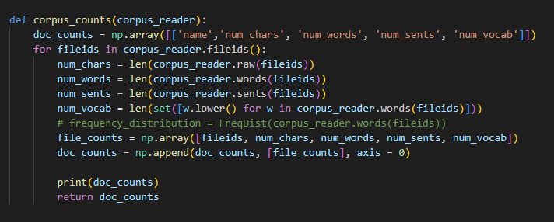
Appendix A: Corpus Counts

Slide 9
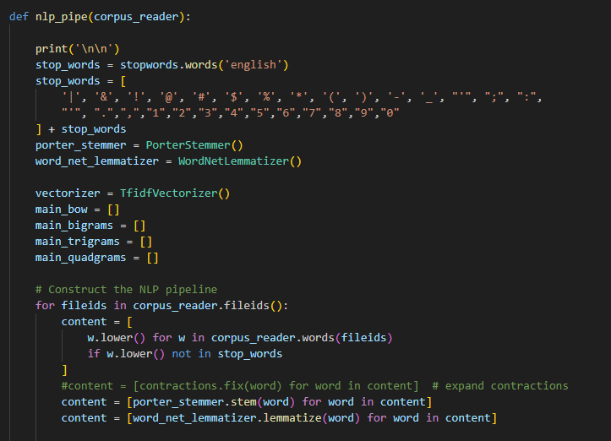
Appendix B: Corpus Counts

Slide 10
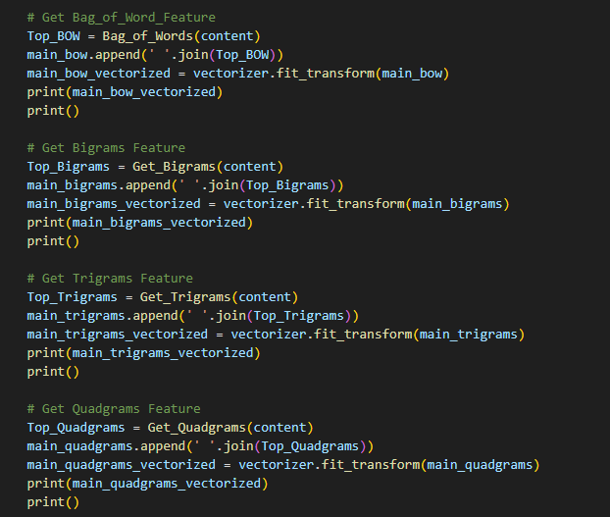
Appendix C: Feature Extraction

Slide 11
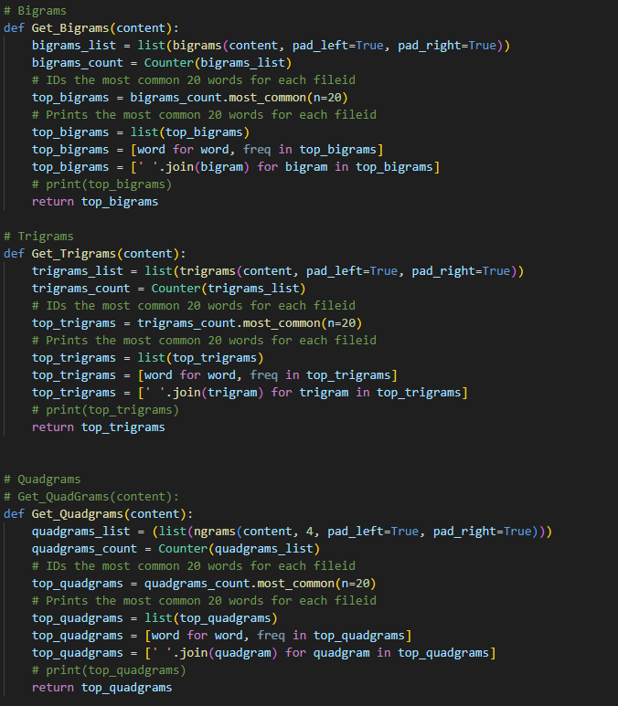
Appendix D: Feature Extraction

Slide 12
Corpus
Lowercase
Stop Words Removal
Stemming
Evaluation
Modeling
Feature Extraction
Lemmatizing

